Slide 1
Multinational Bank Customer Churn
T4: Analytical Avengers
Brunda Mariswamy, Alice Pascalev, Akhil Bharadwaj, Bharath Reddy Duvvi
Final Project

Slide 2
About Customer Churn
Customer Churn prediction means knowing which customers are likely to leave or unsubscribe from the banking service. For many companies, this is an important prediction.
Identifying customers at risk of churn → we need to know exactly what marketing efforts we should make with each customer to maximize their likelihood of staying.
Notes:
Customer churn, also known as customer turnover, occurs when a customer chooses to leave or unsubscribe from a service for any reason. In the context of this project, we are looking at customer churn in banking. Being able to predict customer churn is important because we want to retain as many customers as we can. The idea behind this that (of course you want to keep customers), but also it is cheaper to retain your customers, than having to spend money to acquire new customers to replace the ones that left. Lower customer acquisition costs = more profits. By identifying customers at risk of churn, we are able to identify which efforts in order to maximize their likelihood of staying.

Slide 3
About the Data Set
customer_id Customer ID
credit_score Credit Score
Country
Gender
Age
Tenure (time with bank)
Balance
products_number Number of Banking Products
credit_card Credit Card
active Active member
Estimated_salary Estimated salary
Churn
Data from ABC Multinational Bank, an anonymized data set including customer attributes and their respective banking behaviors.
Source: Bank Customer Churn Data Set Kaggle
10,000 observations of 12 variables

Slide 4
EDA Review:
Customer Analysis

Slide 5
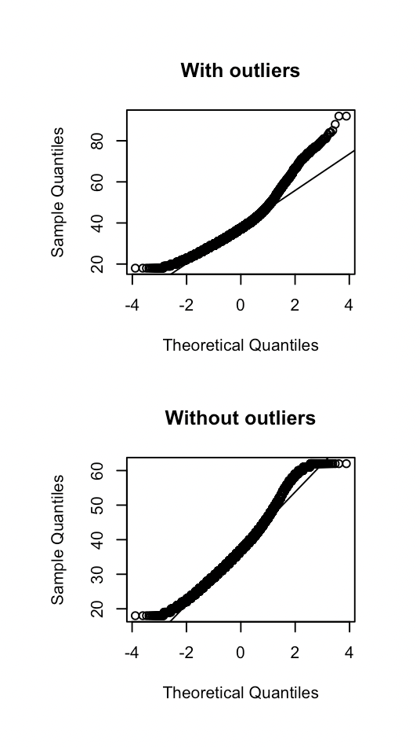
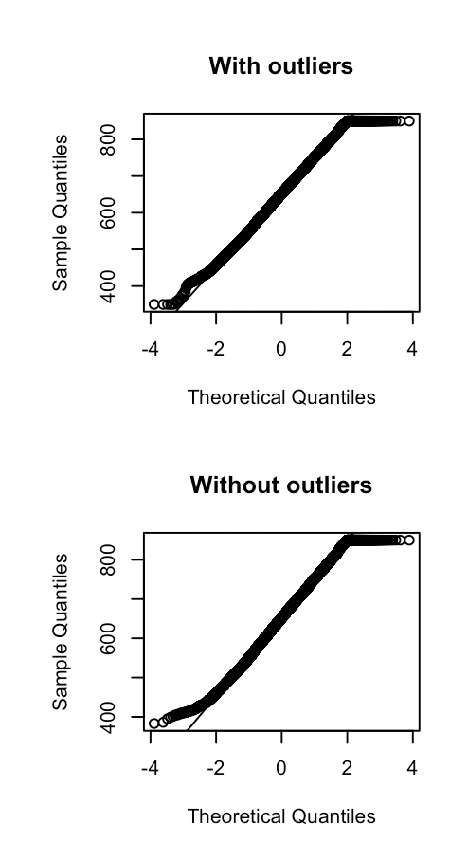
Review: Preparing for EDA (Midterm)
Dropped 1 variable: customer_id
Checked for null values: none found
Converted the following variables into categorical
credit card, active member, churn, gender
Checked for & removed outliers
Checked continuous variables
Removed outliers: age, credit score
Credit Score: 0.2% Age: 3.7%

Slide 6
Review: Customer Analysis (Midterm)
The average credit score of the customer is 650.529
More than 50% of ABC Multinational Bank’s accounts are based in France
The majority of the bank customers fall under the age of 50 with average age of 38.922
Most of the customer been with bank for more than a year.
71% of customers use credit card
45.4% of the customers are Female, 55.6% are male
51.5% of members have Active Status
50.8% use 1 product, 45.9% use 2 products, 2.7% use 3 products, ~0.6% use 4 products
20% of customers are churned
Notes:
By using outlierKD function we can observe that outliers where found only in age and credit_card variables i.e,3.7% and 0.2%. Other variables balance, tenure, salary were 0

Slide 7
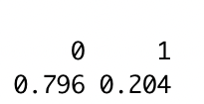
Probability Table
Retained
Churned

Slide 8
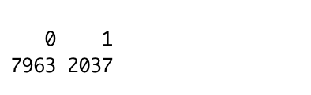
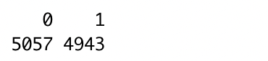
Next Steps: Handling Imbalanced Data
79.6% of customers are retained, with a minority of 20.4% churned. In our training set, we utilized undersampling in order to even out our target, Churn

Slide 9
Preparing for PCA
Our data frame contains integer, character, and numeric type. We need to standardize this data before we are able to continue.
We converted all character data to numeric, before proceeding, using the as.numeric function.
With our data in number form, we are able to scale the data using scale() to look at the correlation and covariance matrices, and work on the PCA.

Slide 10
S.M.A.R.T. Questions

Slide 11
The big question:
What factors affect the Customer Churn Rate in Multinational banks?

Slide 12
Does the combination of customer demographic variables country, age group, gender influence the churn rate?
Whether the customers using fewer products with higher salary,account balance and status of the account affect the churn rate?
Which model can give the best results based on adjusted R square value, along with lower BIC and Cp?
What are the principal components for predicting churn rate?

Slide 13
Model Building & Training

Slide 14
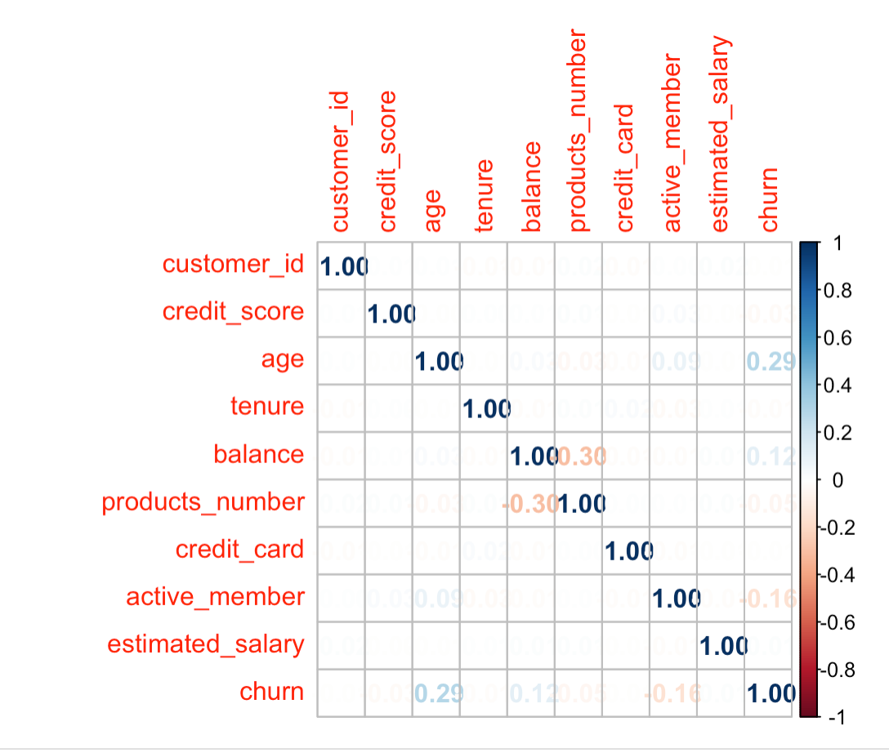
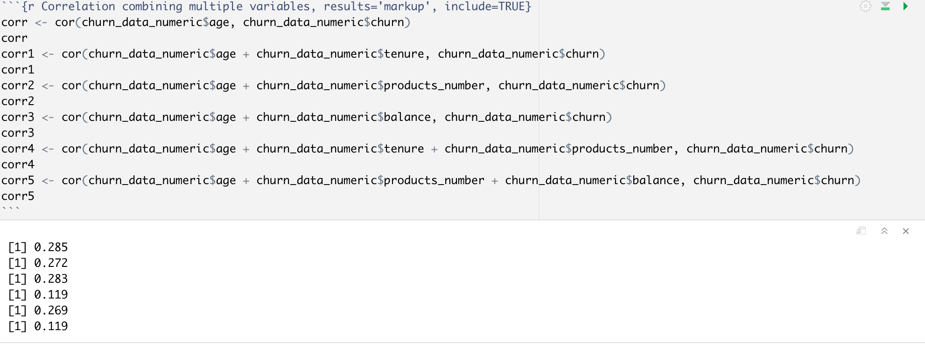
Correlation plot
Notes:
The correlation score is the highest for the age variable. After combining different columns and finding the correlation score we see that it starts decreasing from 0.285

Slide 15
Does the combination of customer demographic variables country, age group, gender influence the churn rate?

Slide 16
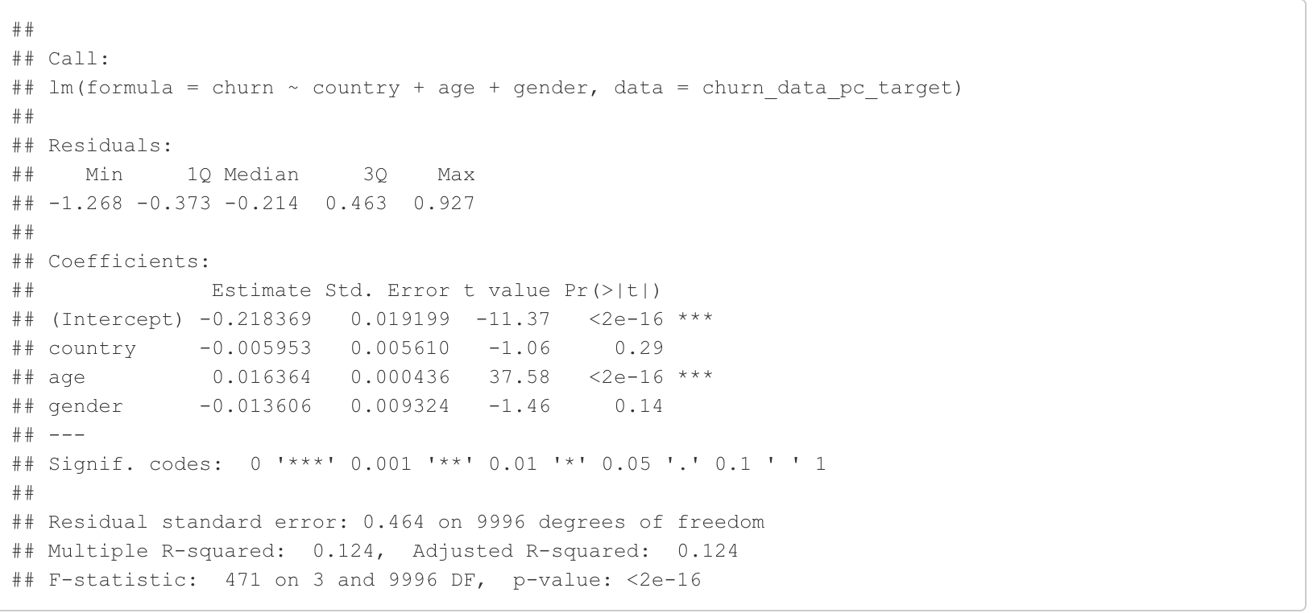
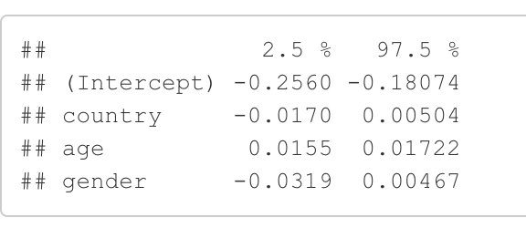
Confident Interval

Slide 17
Whether the customers using fewer products with higher salary,account balance and status of the account affect the churn rate?

Slide 18
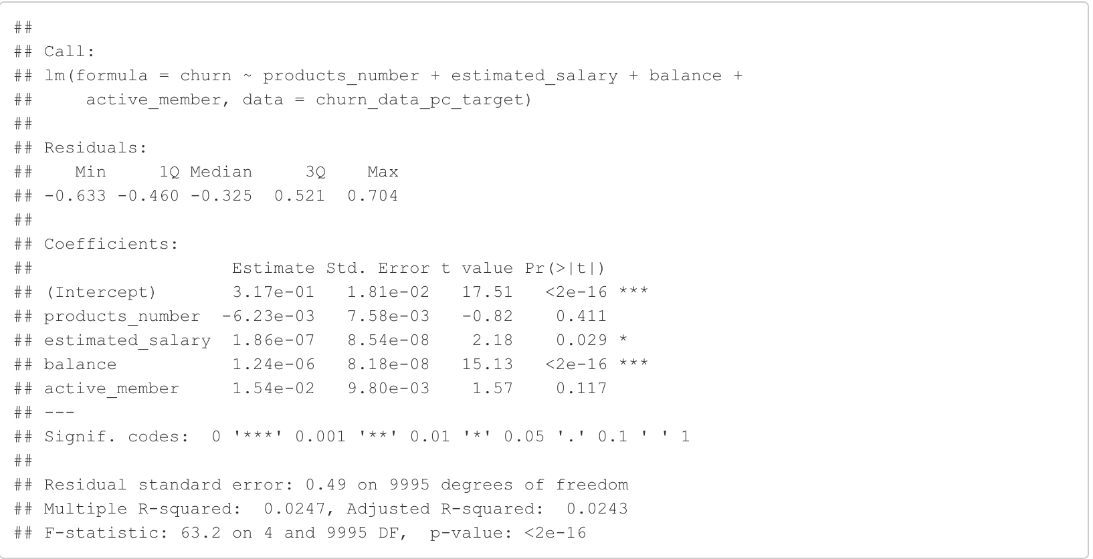
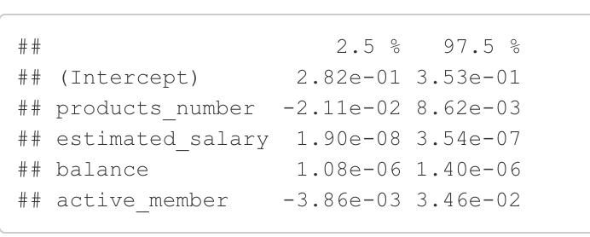
Confident Interval

Slide 19
Finding Best Model

Slide 20
Which model can give the best results for adjusted R square value with lower BIC and Cp?

Slide 21
Feature Selection

Slide 22
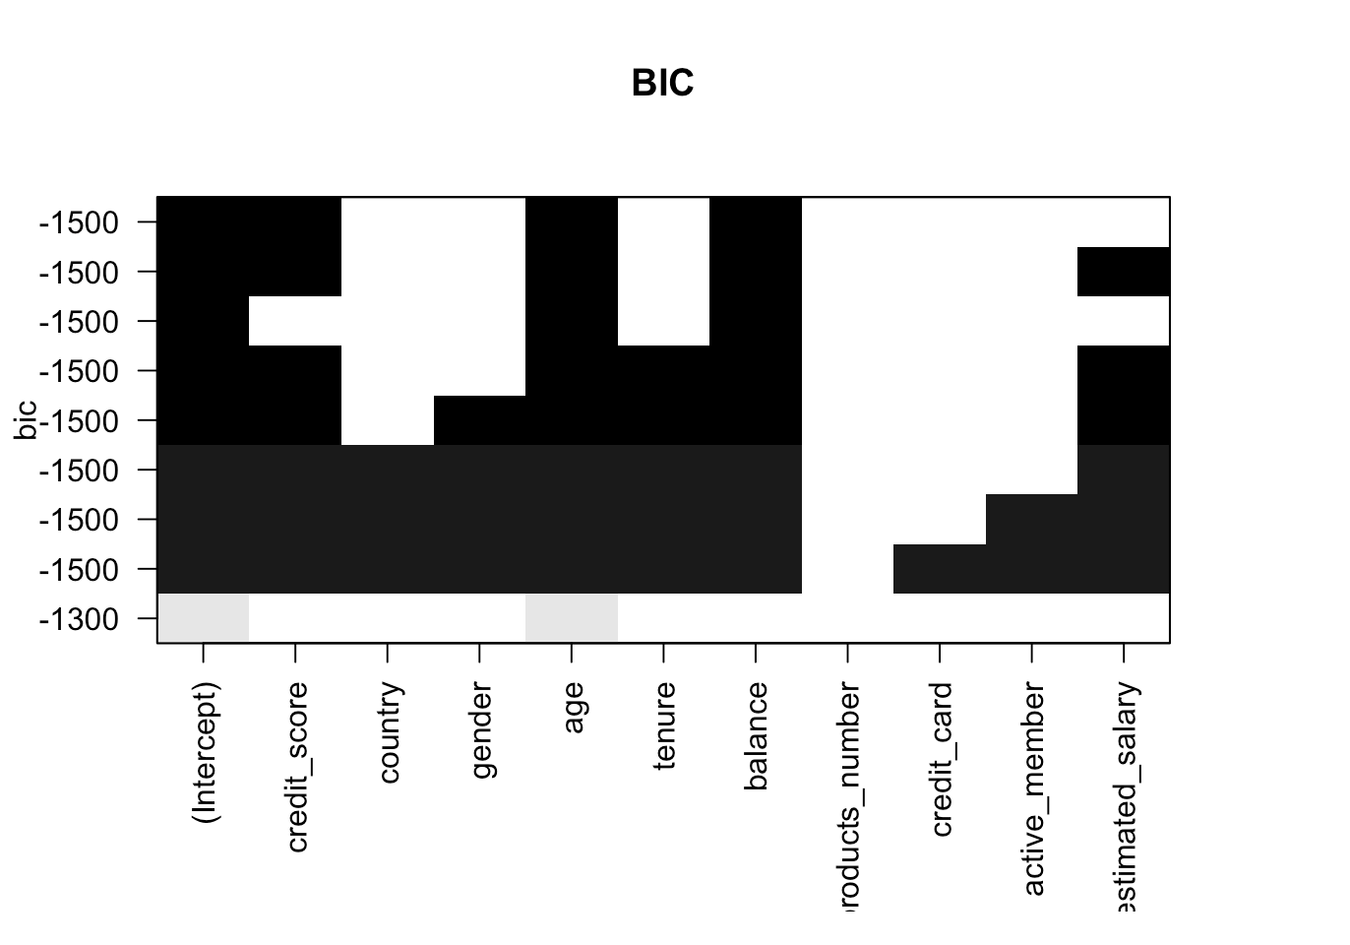
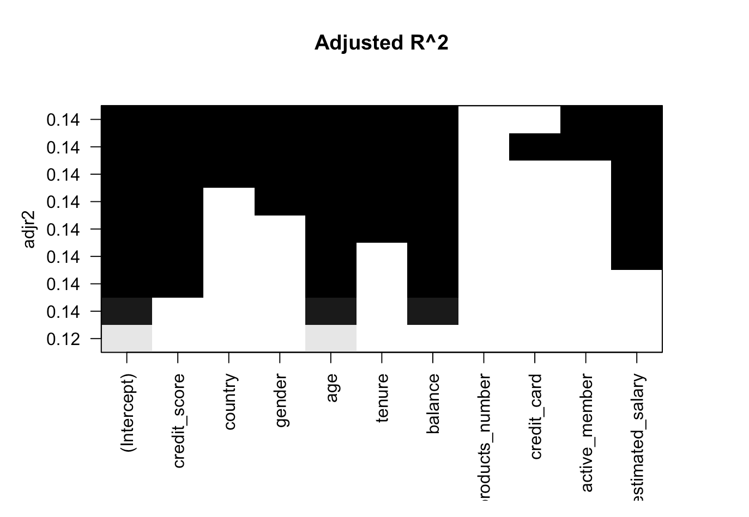
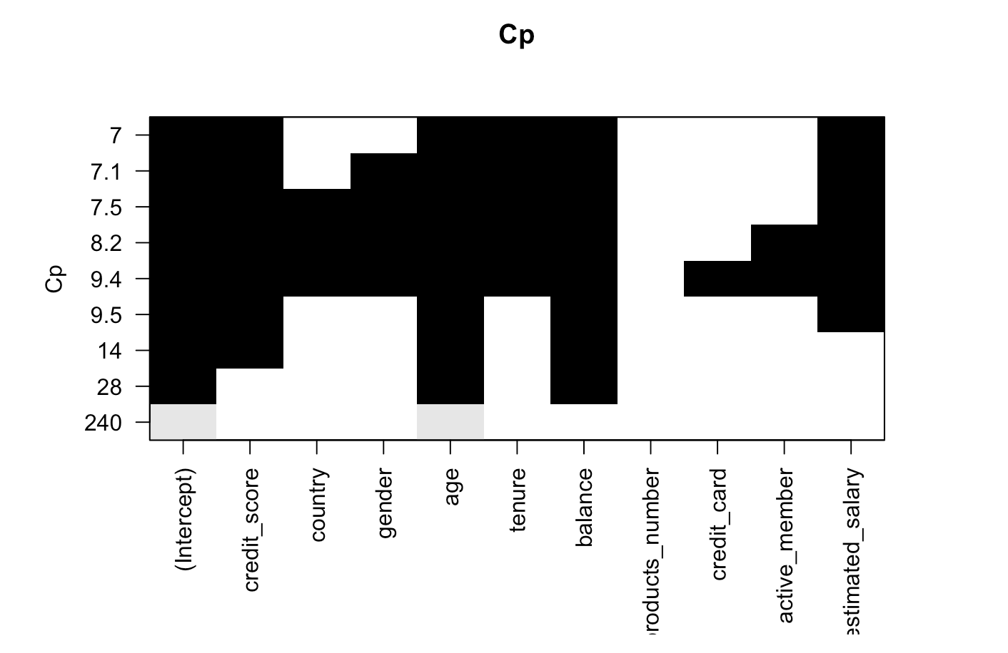
Feature selection : Exhaustive Search Method
age,balance
credit_score,age,balance
credit_score,age,tenure,balance,estimated_salary

Slide 23
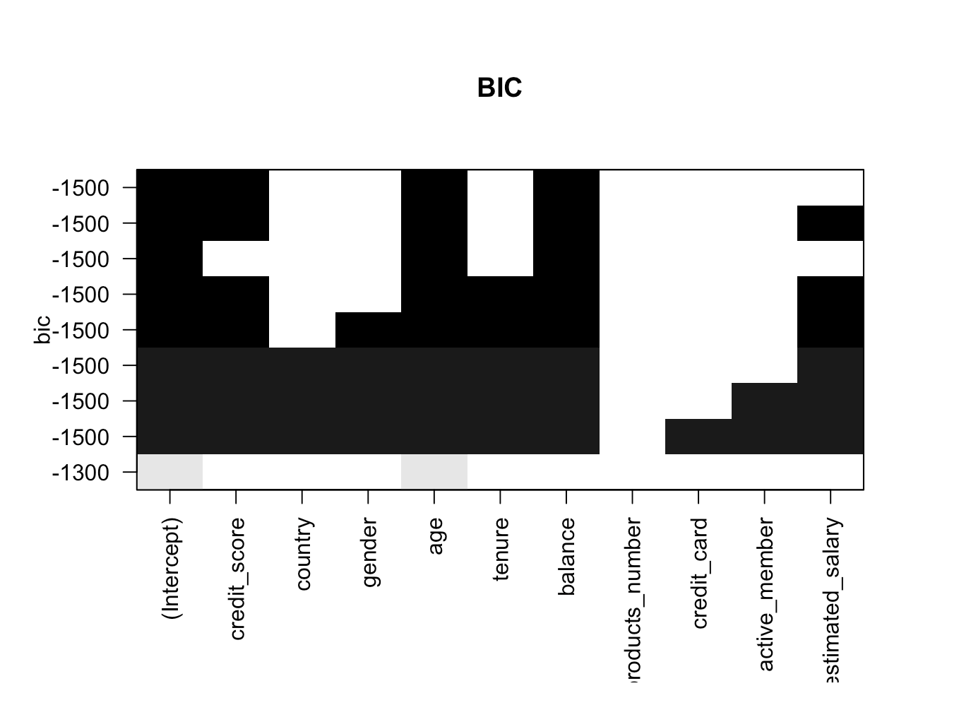
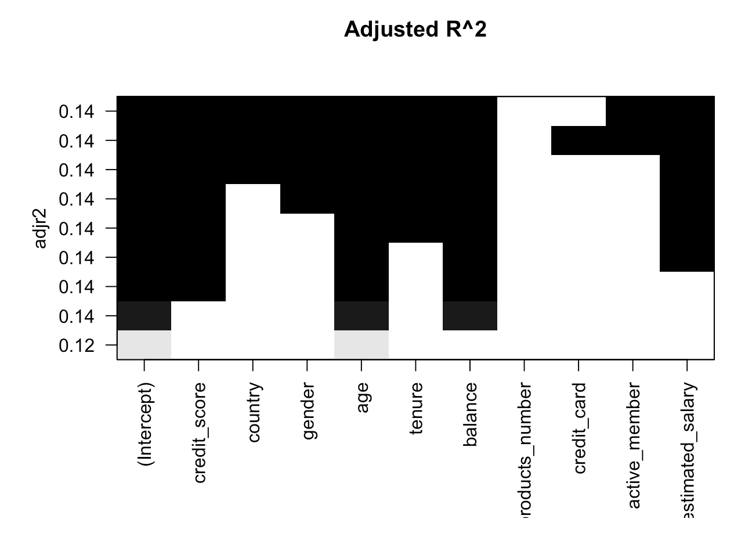
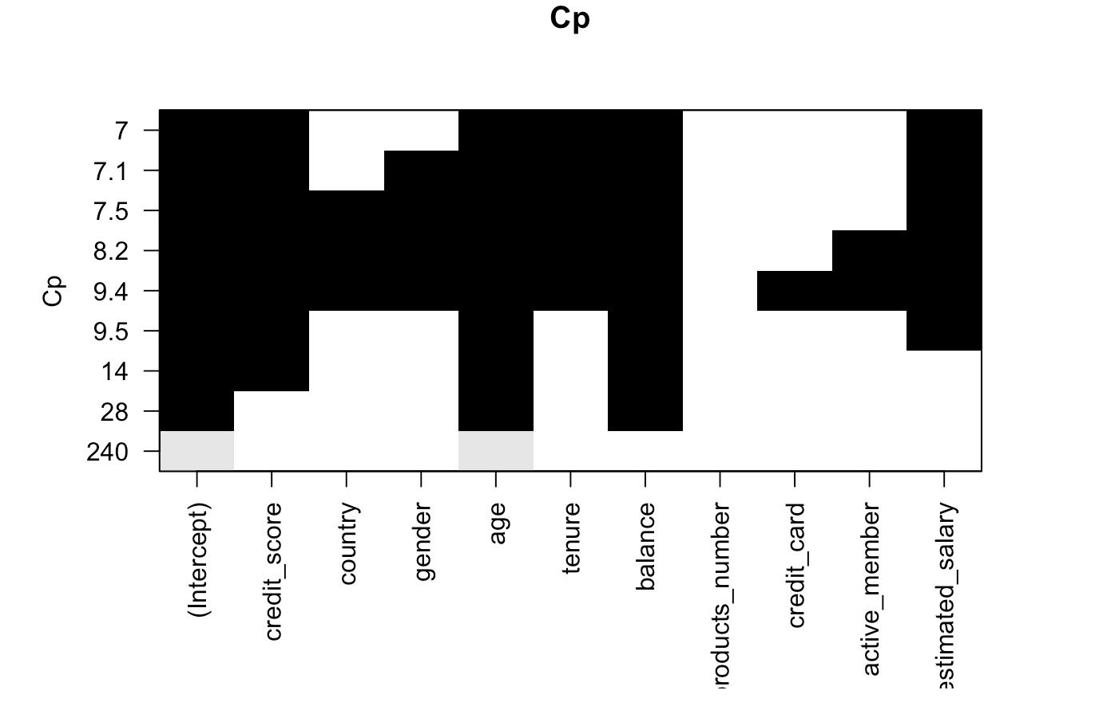
Feature selection : Forward Search Method
age,credit_score,balance,
age,balance
credit_score,age,tenure,balance,estimated_salary

Slide 24
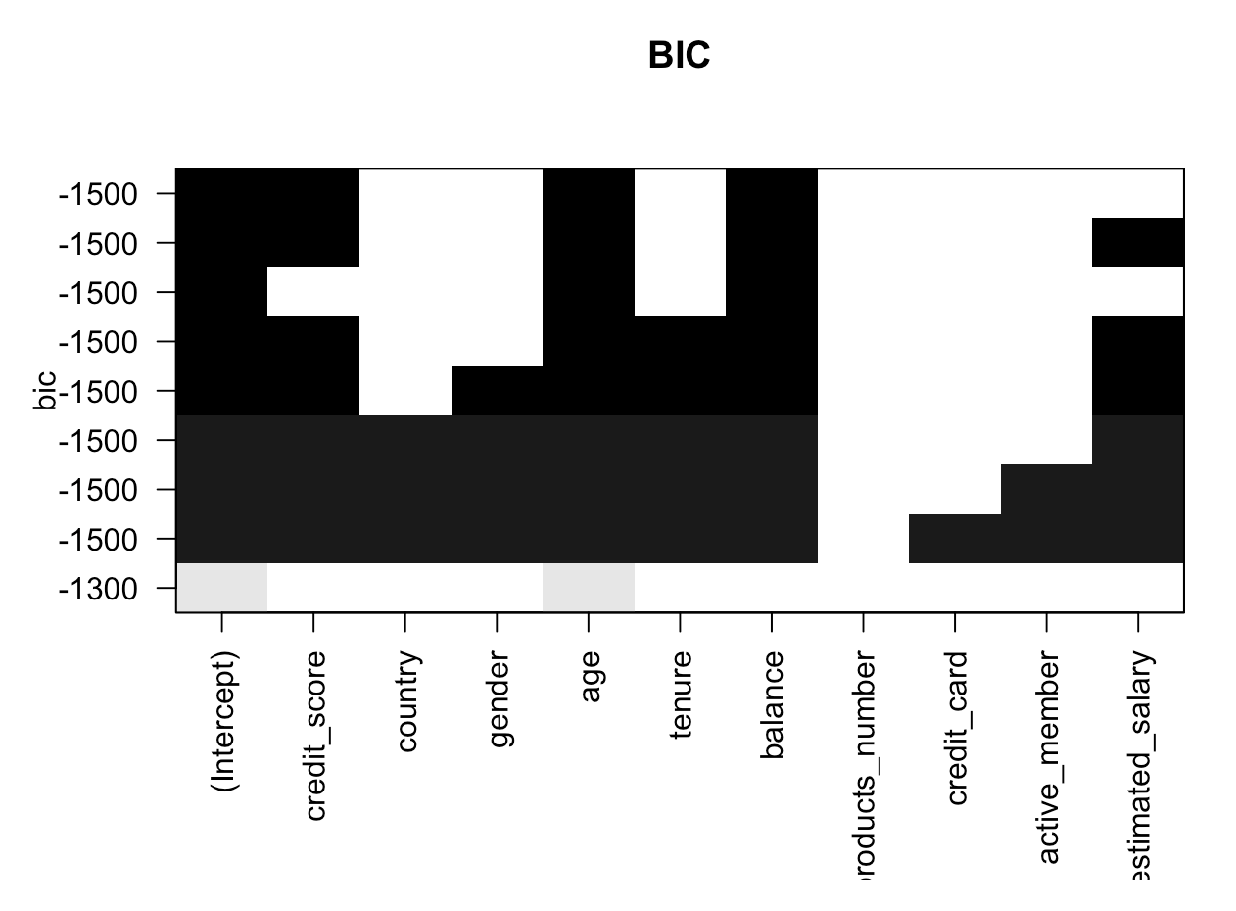
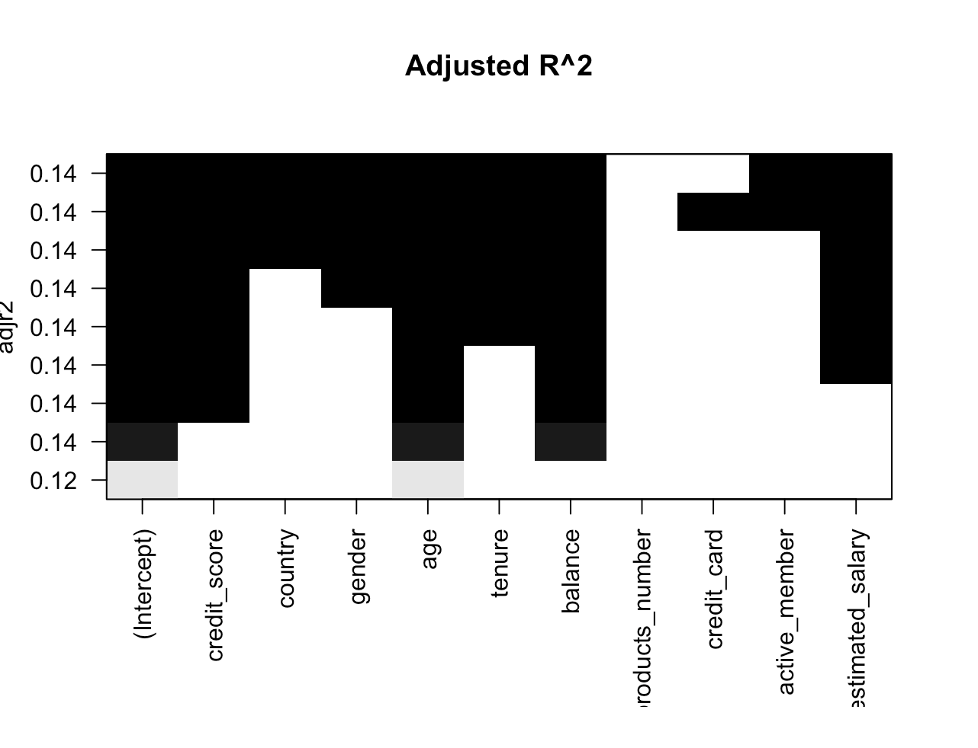
Feature selection : Backward Search Method
credit_score,age,balance
age,balance
credit_score,age,tenure,balance,estimated_salary

Slide 25
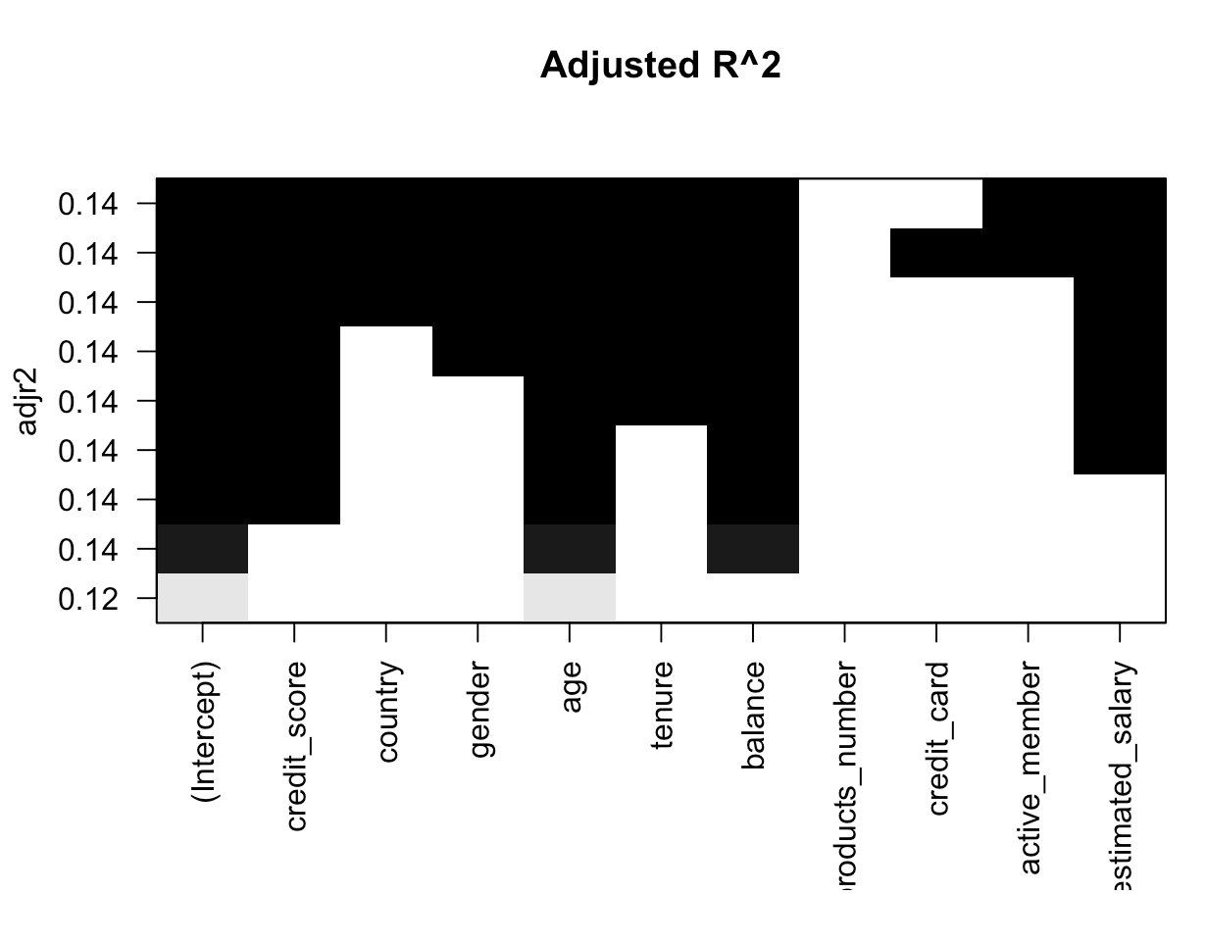
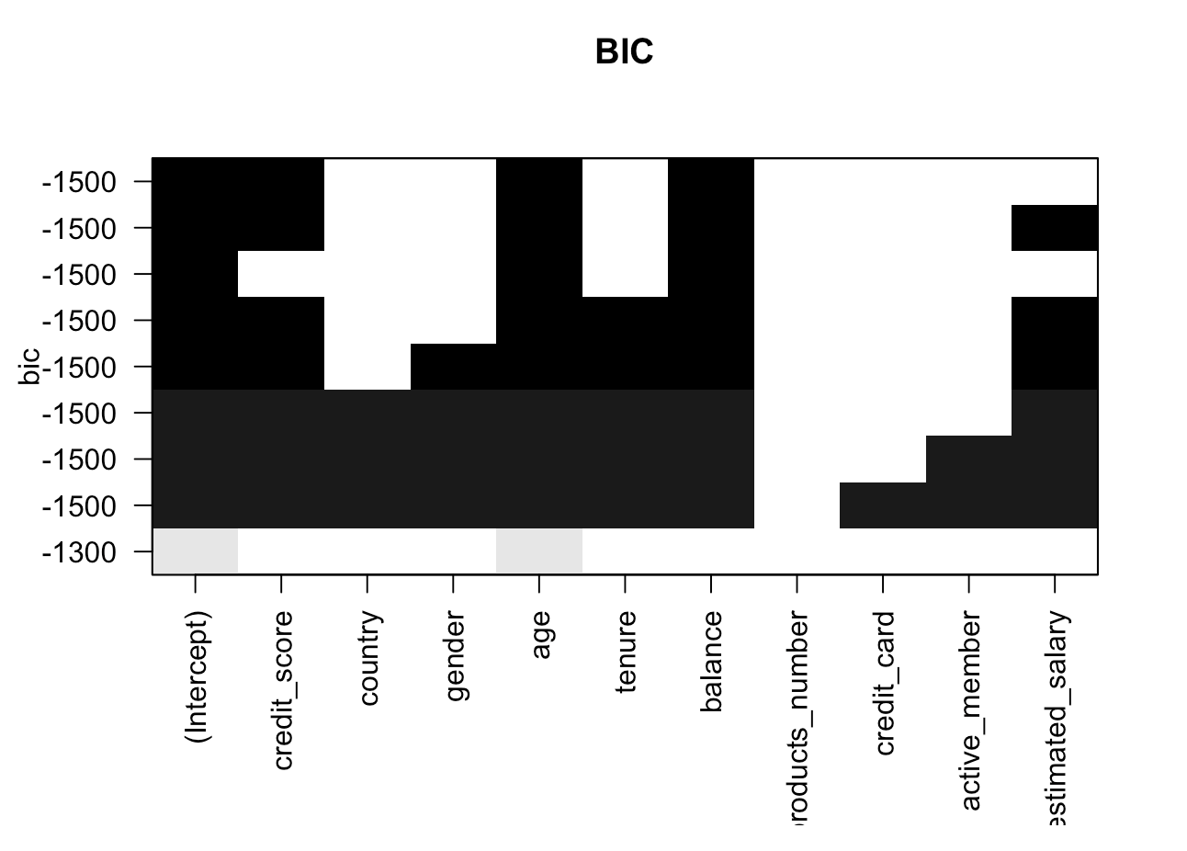
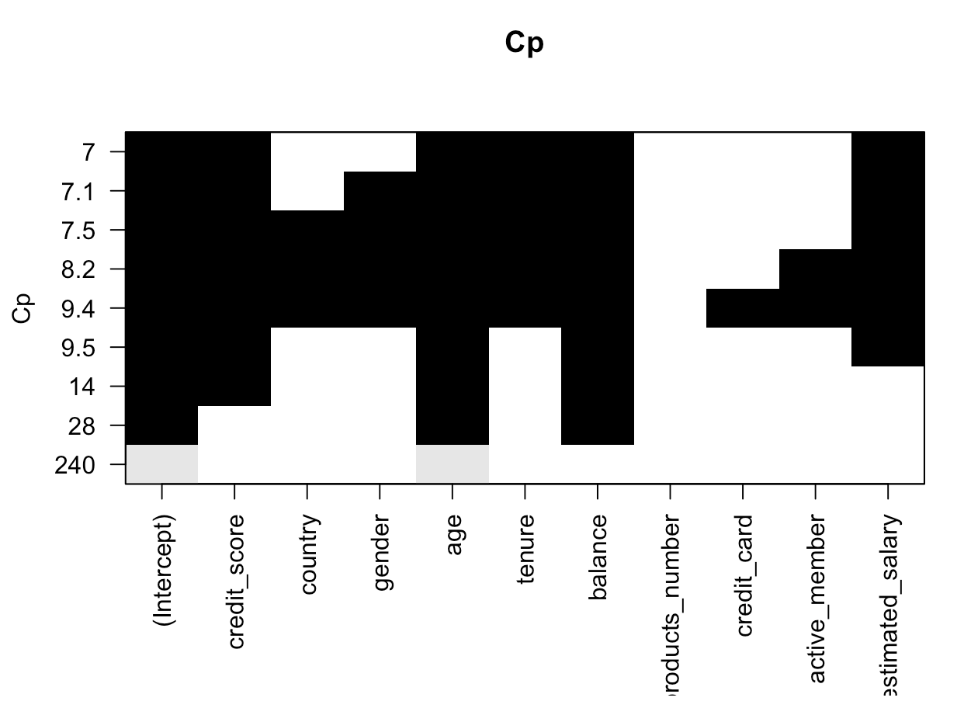
Feature selection : Sequential Search Method
age,balance
credit_score,age,balance,estimated_salary
credit_score,age,tenure,balance,estimated_salary

Slide 26
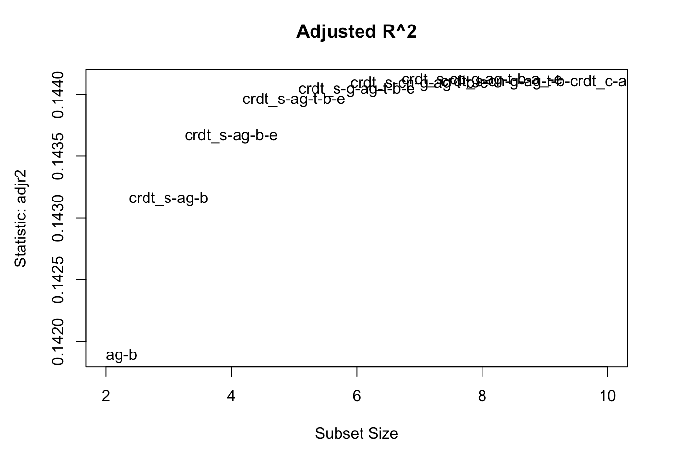
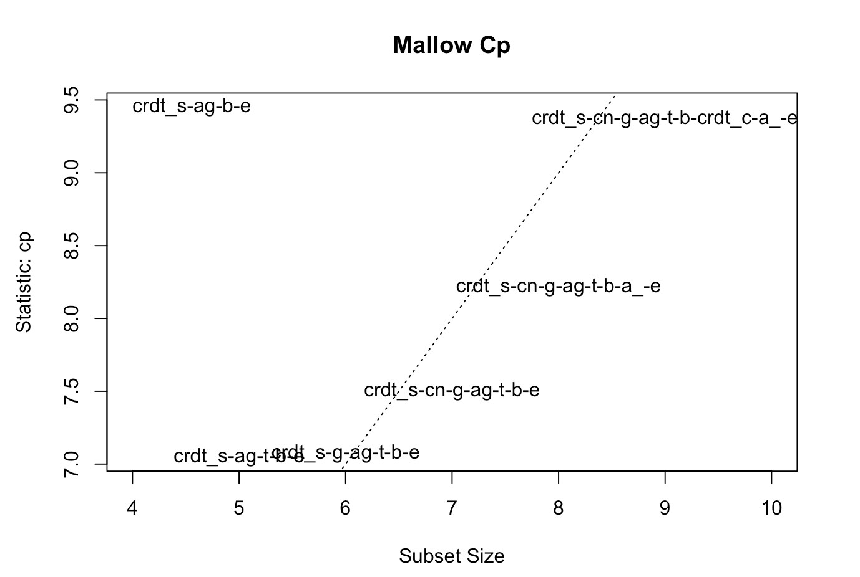
Feature selection : Adjusted R^2 plot

Slide 27
Feature Selection
Suggested Models
1 Age, balance(2 variable model)
Forward search: Adj R^2,
Exhaustive search: Adj R^2
Backward search: Adj R^2
Sequential search:Adj R^2
2 Credit_score, age, balance(3 variable model)
Forward search: BIC
Exhaustive search: BIC
Backward search: BIC
Sequential search:BIC
3 Credit_score, age, tenure, balance, estimated_salary(5 variable model)
Exhaustive search: CP
Forward search: CP
Backward search: CP
Sequential search: CP
4 Credit_score,country,gender,age,tenure,balance,active_member,estimated_salary(8 variable model)
Mallow CPG
5.Credit_score, country, gender, age, tenure, balance, estimated_salary(7 variable model)
Mallow CPG

Slide 28
What are the principal components for predicting churn rate?

Slide 29
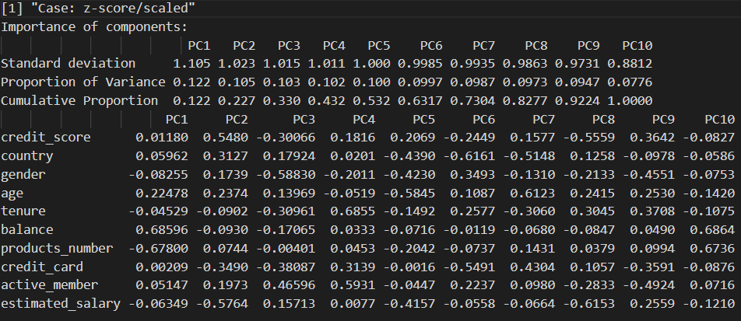
Principal Component Analysis

Slide 30
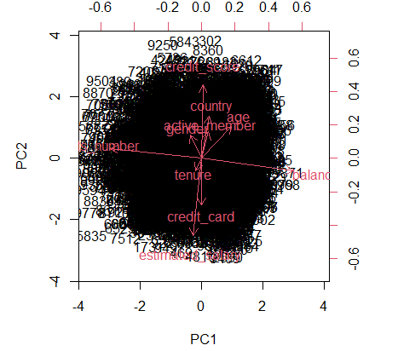
Principal Component Analysis

Slide 31
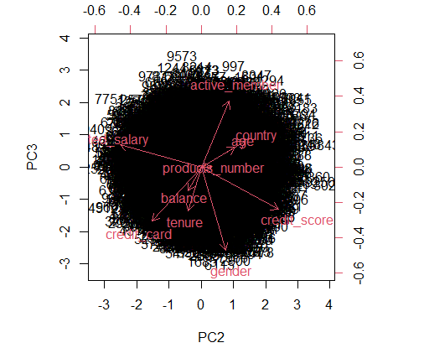
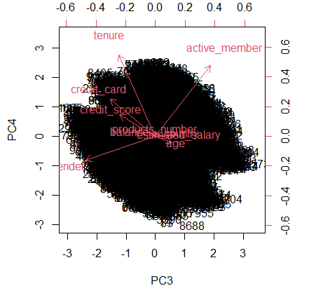

Slide 32
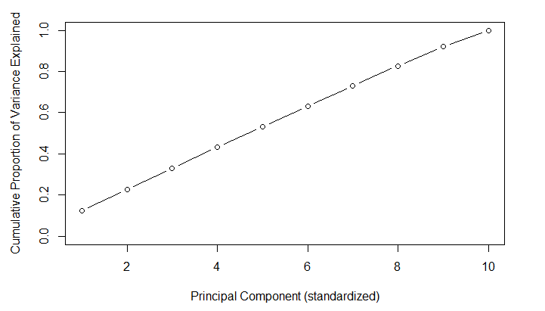
Principal Component Analysis
Knee
From the graph for Proportion of variance we can see that almost 90% of variance is explained by 9 principal components.
Knee

Slide 33
Logistic Regression
Comparing models

Slide 34
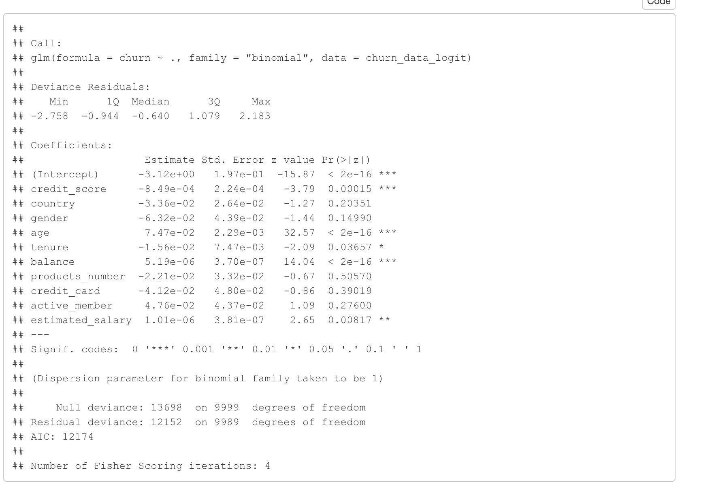
Statistically significant variables

Slide 35
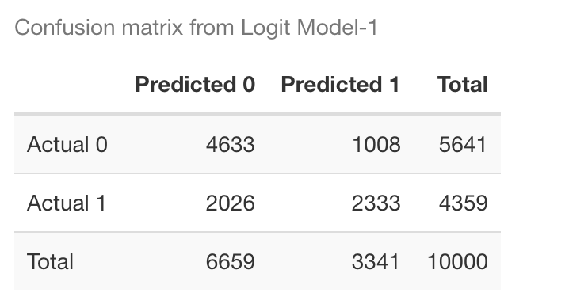
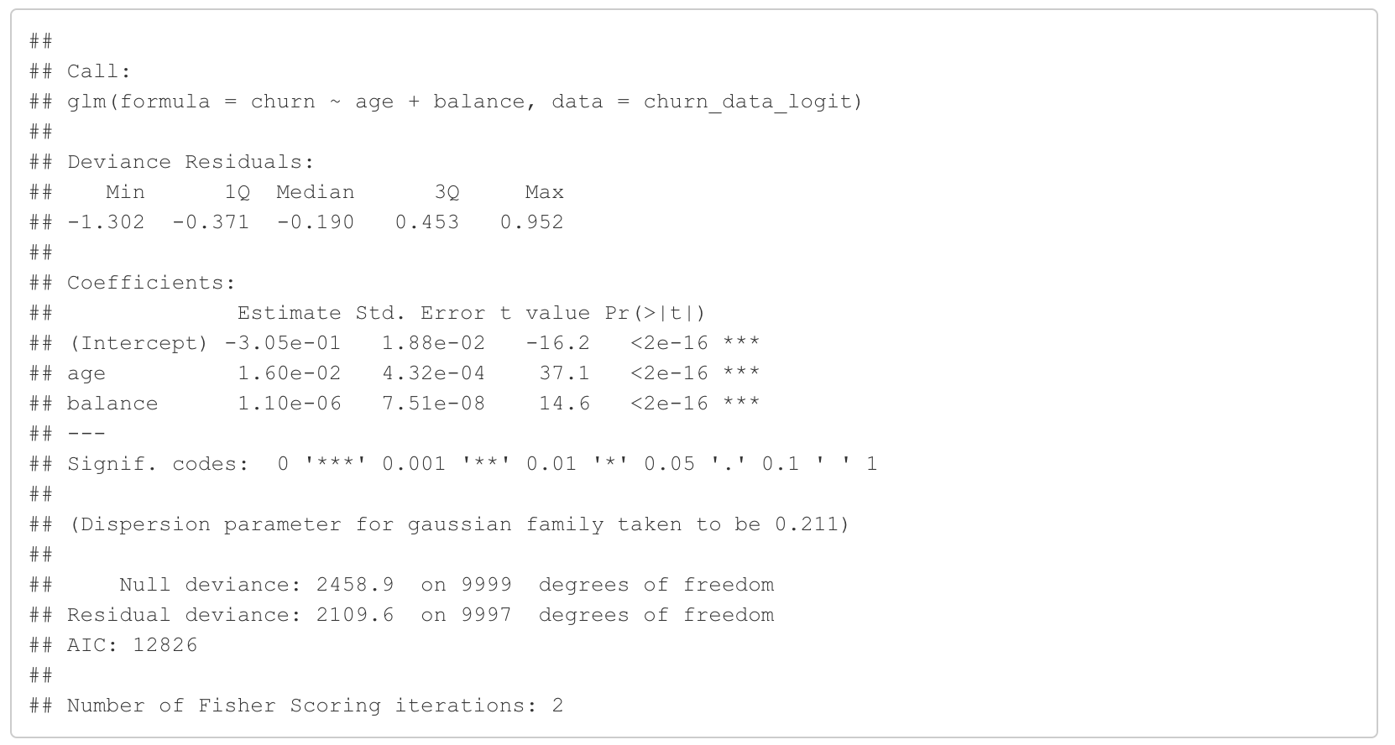
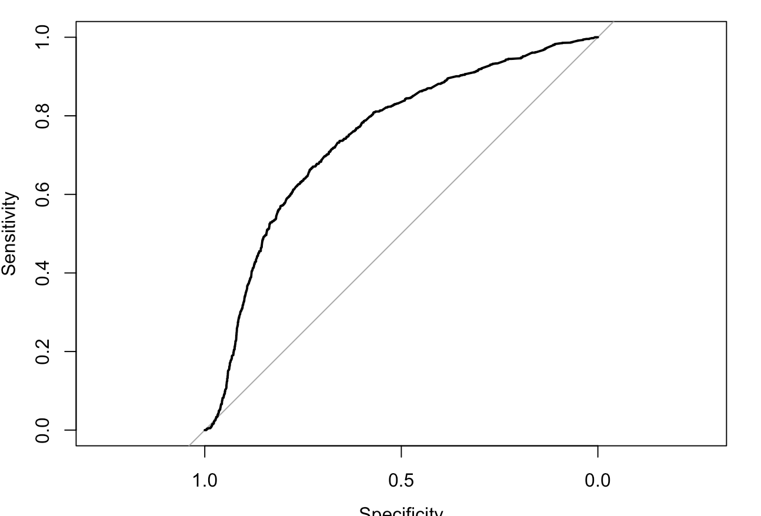
1 Age, balance
Area under the curve: 0.744

Slide 36
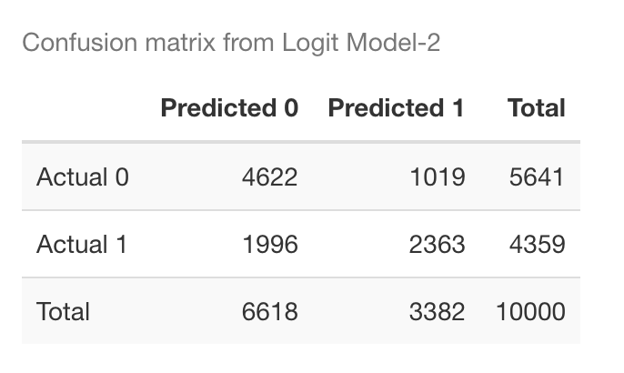
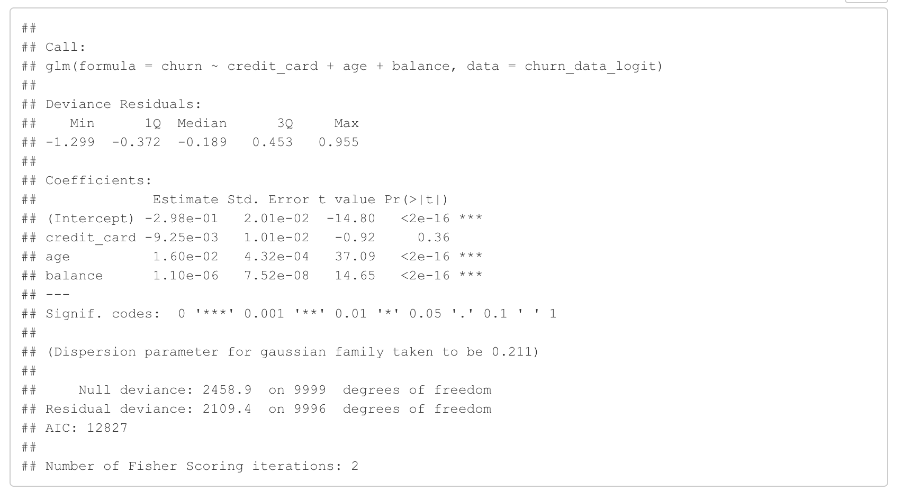
2 Credit_card,age, balance
Area under the curve: 0.744

Slide 37
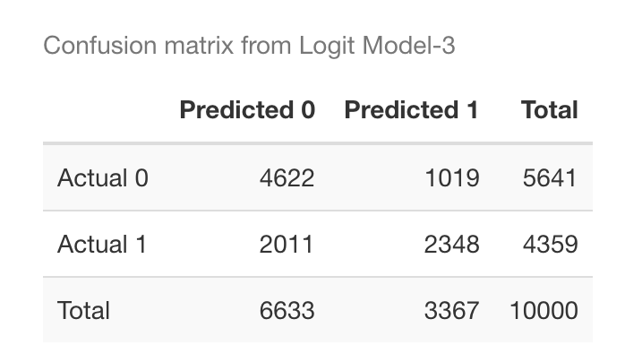
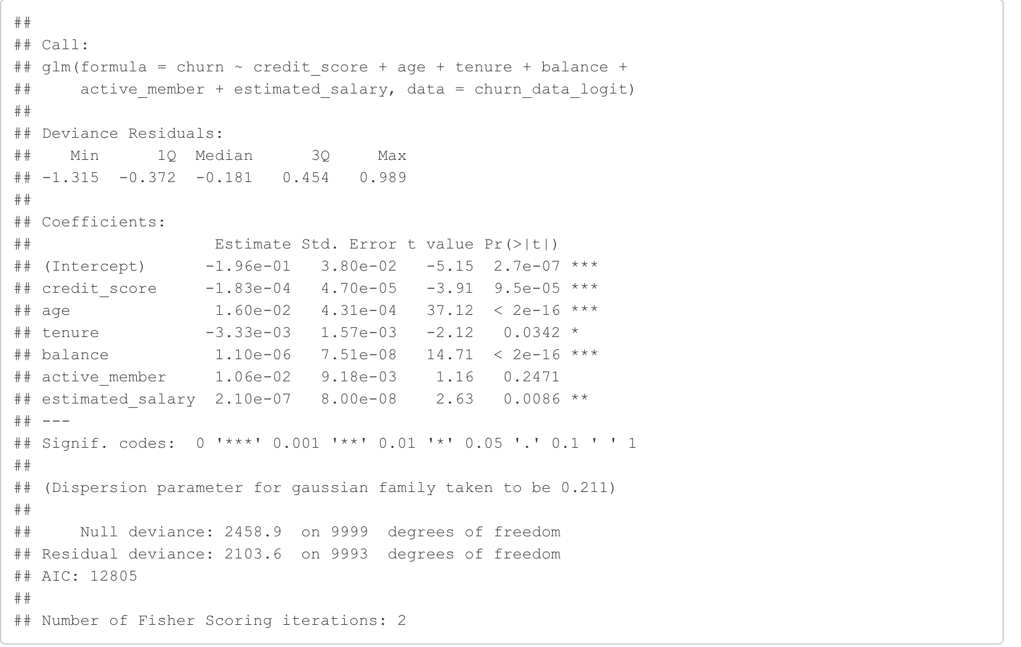
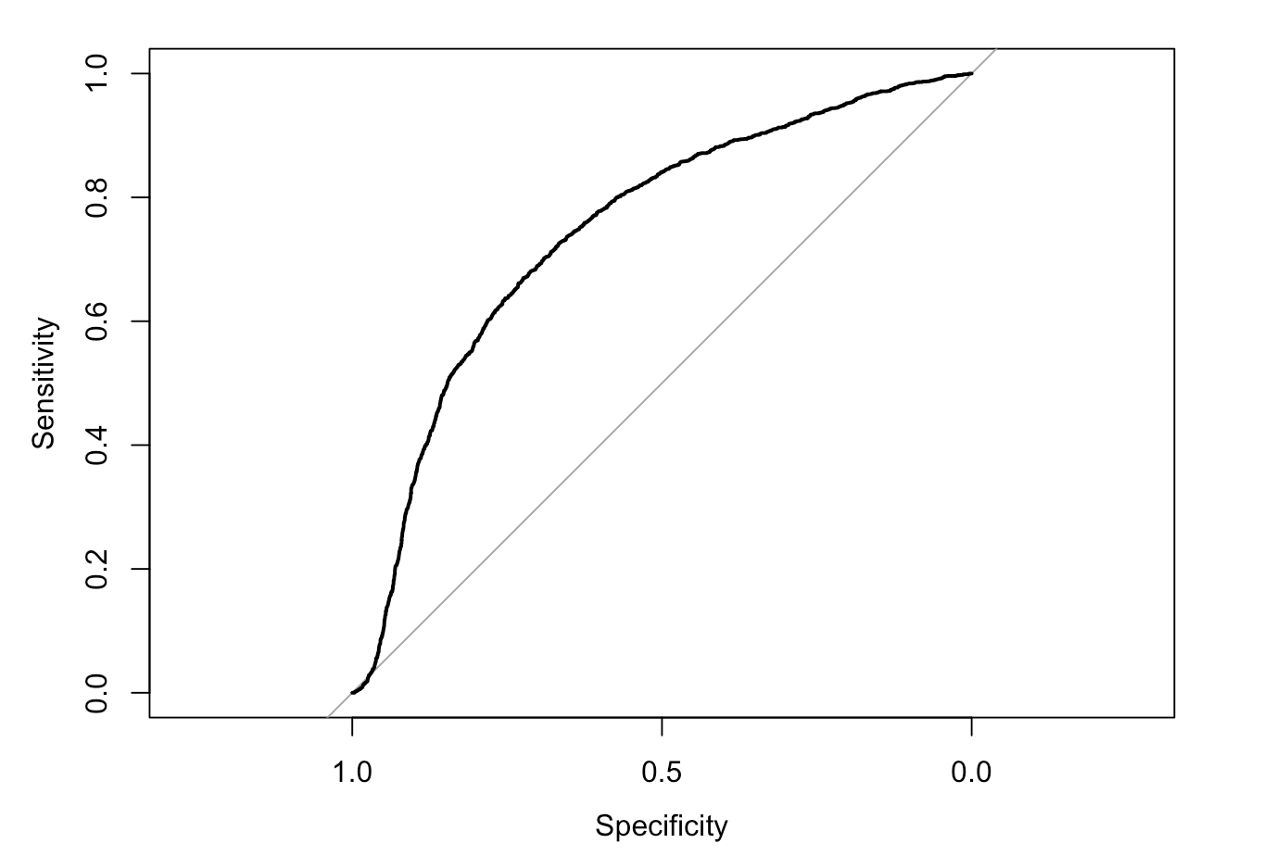
3 Credit_score,age, tenure,balance, active_member,estimated_salary
Area under the curve: 0.744

Slide 38
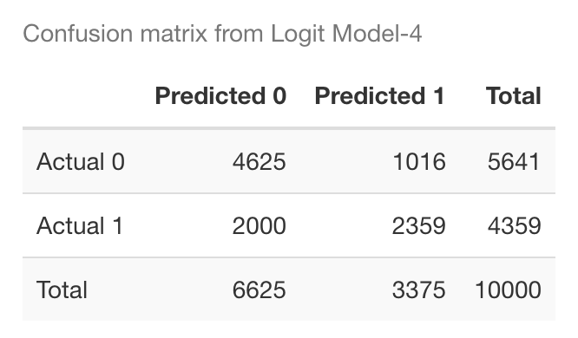
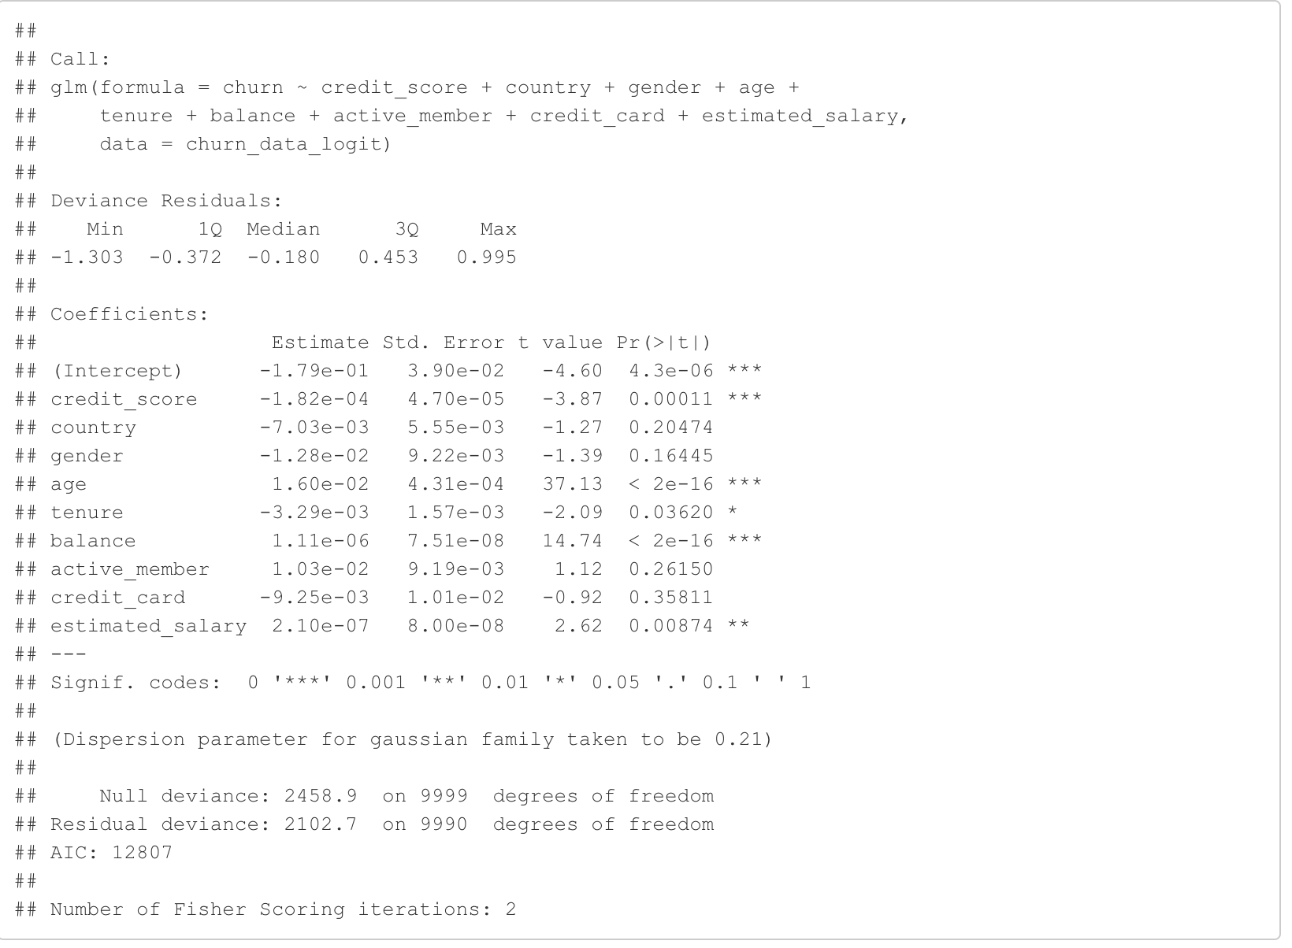
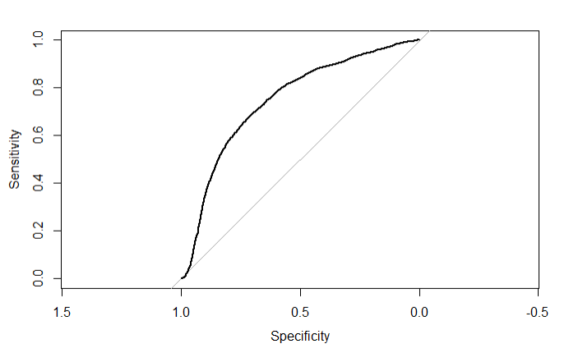
4 Credit_score, country, gender, age, tenure,balance, active_member,credit_card,estimated_salary
Area under the curve: 0.745

Slide 39
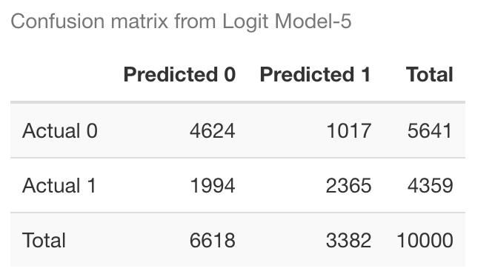
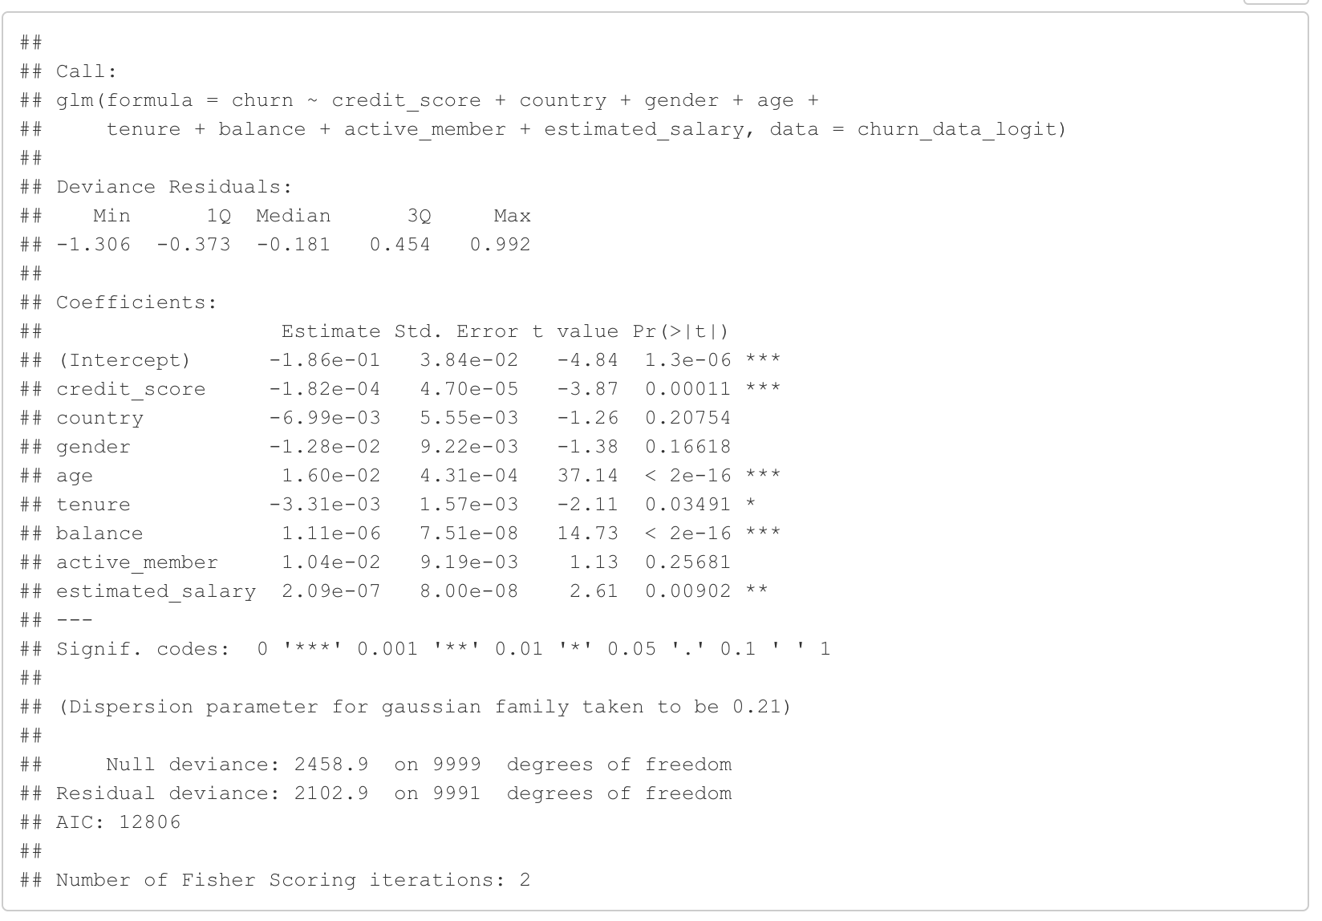
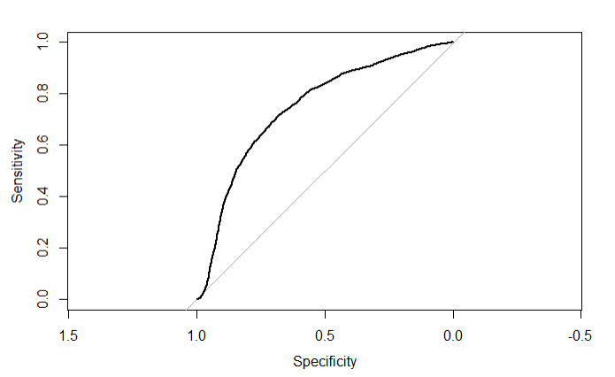
5 Credit_score, country, gender, age, tenure, balance, active_member,estimated_salary
Area under the curve: 0.745

Slide 40
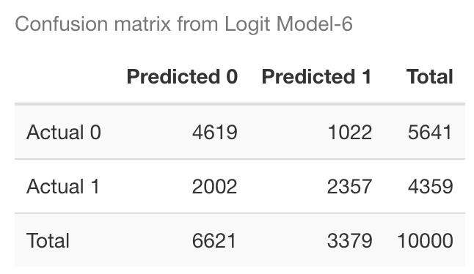
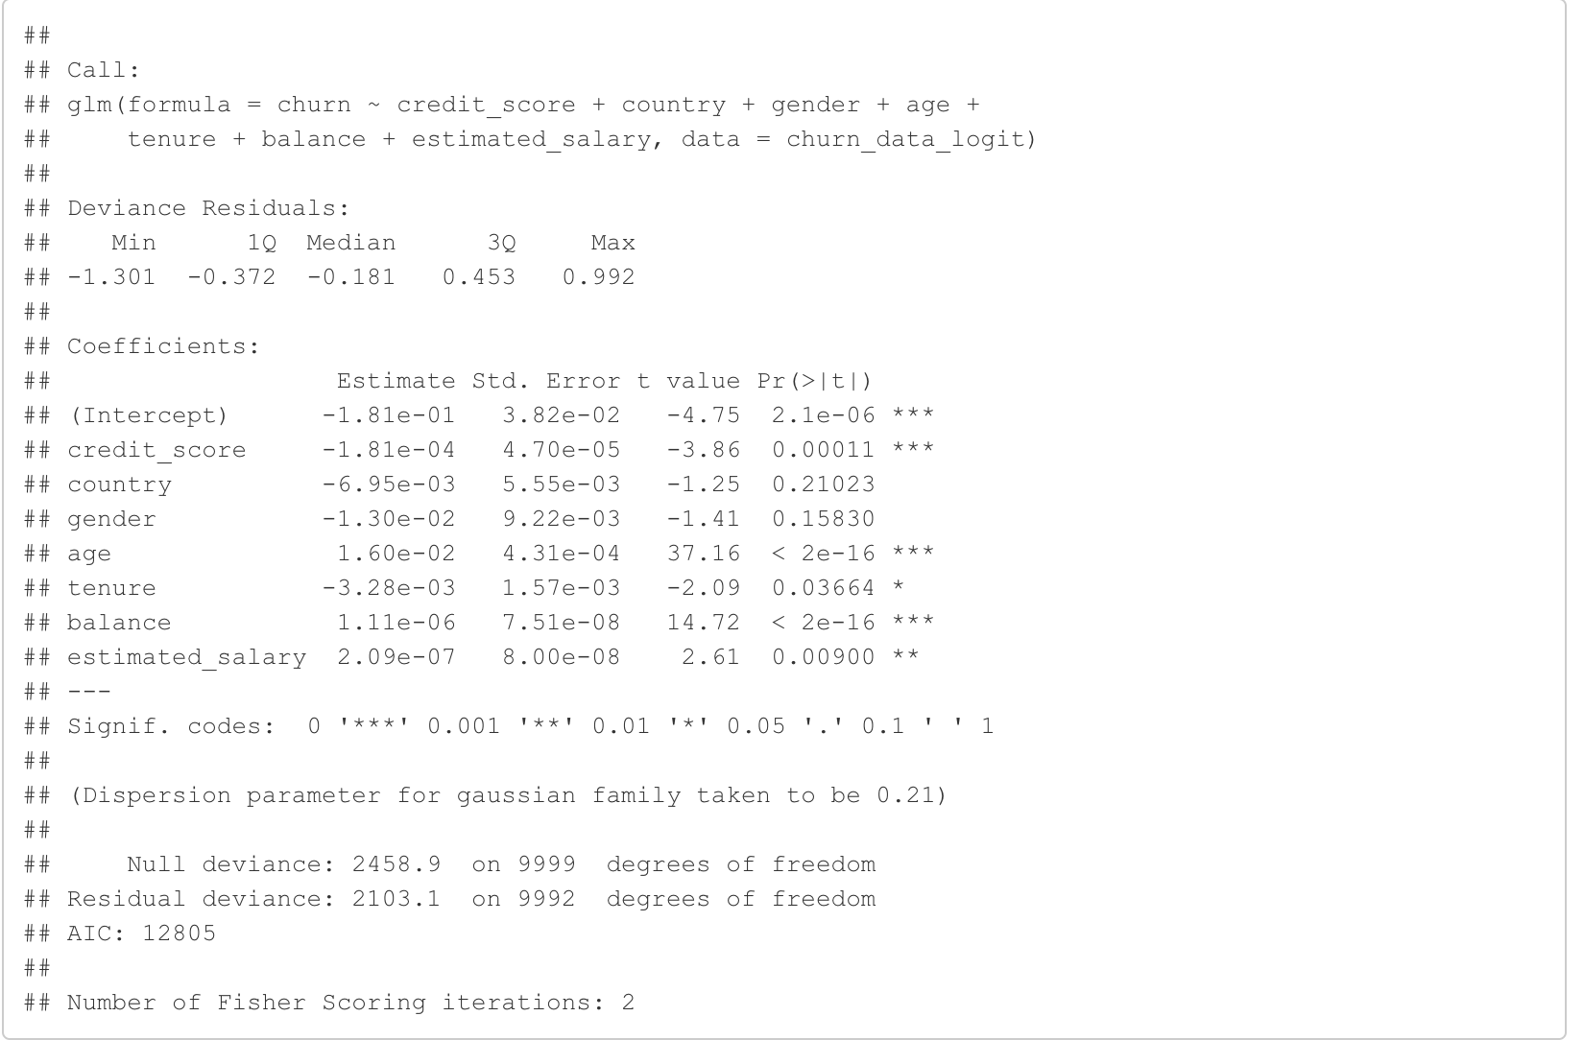

6 Credit_score,country,gender,age,tenure,balance,estimated_salary
Area under the curve: 0.745

Slide 41

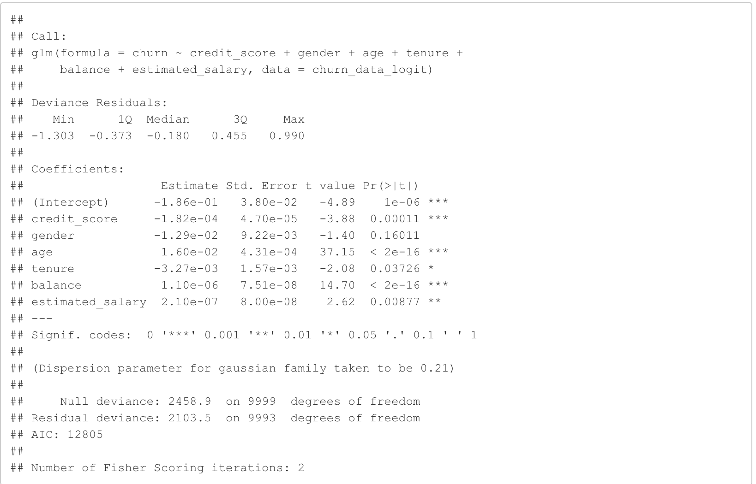

7 Credit_score, country, gender, age, tenure, balance, estimated_salary
Area under the curve: 0.745

Slide 42
Best Logistic Regression Model
Model 5 with features Credit_score, country, gender, age, tenure, balance, active_member,estimated_salary seems to be the best model which has comparatively lower False Negatives and the area under curve 0.745.
glm(churn ~ credit_score + country + gender+age+tenure+balance+active_member+estimated_salary, data = churn_data_logit)
We are focusing particularly on False negatives because it is vital for any bank to correctly predict churn and in an ideal scenario without any errors.

Slide 43
Summary
When creating a model based solely on customer demographics, only the age variable is significant
When creating a model based on salary and account features (number of products, balance, active status), only the balance variable is significant
90% of variance explained by 9 principle components
PC9 Cumulative proportion of variance: 0.92

Slide 44
Summary cont.
Best model Adj R^2: Age + Balance
Best model BIC: Credit Score + Age + Balance
Best model Cp: Credit Score + Age + Balance + Tenure + Est. Salary
Best predictor of customer churn over all:
Model 5, which includes features Credit_score + country + gender + age + tenure + balance + active_member + estimated_salary is best performing
Area under curve: 0.745
Least false negatives compared to other models with same area under curve

Slide 45
Questions?

